Slide 1

Spotify Clone
BODY Tshungini Archimède – International Business and Entrepreneurship (IBE)
Department of Computers Science for Business Management
Romanian American University
Bd. Expoziției, Nr.1B, Sector 1, cod 012101
Romania, Bucharest
bodytshungini.b.archimede23@stud.rau.ro
Bucharest 2024

Slide 2
App Introduction
Purpose: The Spotify Clone app allows users to browse, play, and manage their music collections. Users can create playlists, mark favorite songs, and enjoy a seamless music playback experience.

Slide 3
App Introduction
Core Functionalities:
Music playback with play/pause functionality.
Favorite songs management.
User profile and personalized data.
Firebase-based backend for authentication and data management.

Slide 4
Target Audience
Primary Users:
Music enthusiasts who want a simple app to browse and play music.
Users looking for playlist management and personalized experiences.
Why It’s Useful:
Provides an accessible and customizable music library.
Offers a user-friendly interface for managing and discovering songs.

Slide 5
Technical Architecture

Slide 6
Technical Architecture
Entity-Relationship Diagram (ERD)

Slide 7
Database Structure
Entities
Users: User details like name, email, profile image.
Songs: Song metadata including title, artist, duration, release date.
Favorites: A collection of user-specific favorite songs.
Description
Users:
Stores user information, linked to their favorite songs.
Songs:
Central repository for all available songs.
Favorites:
Many-to-one relationship with users, mapping their favorite songs.

Slide 8
Backend Architecture
Architecture Diagram
Firebase Authentication: Handles user login and registration.
Firebase Firestore: Stores user data, songs, and favorites.
Firebase Storage: Hosts song audio files and cover images.
Description
Authentication:
Provides secure user login via email/password.
Firestore:
Houses collections for users, songs, and their favorites.
Storage:
Efficiently stores and serves media files (e.g., song covers, audio files).

Slide 9

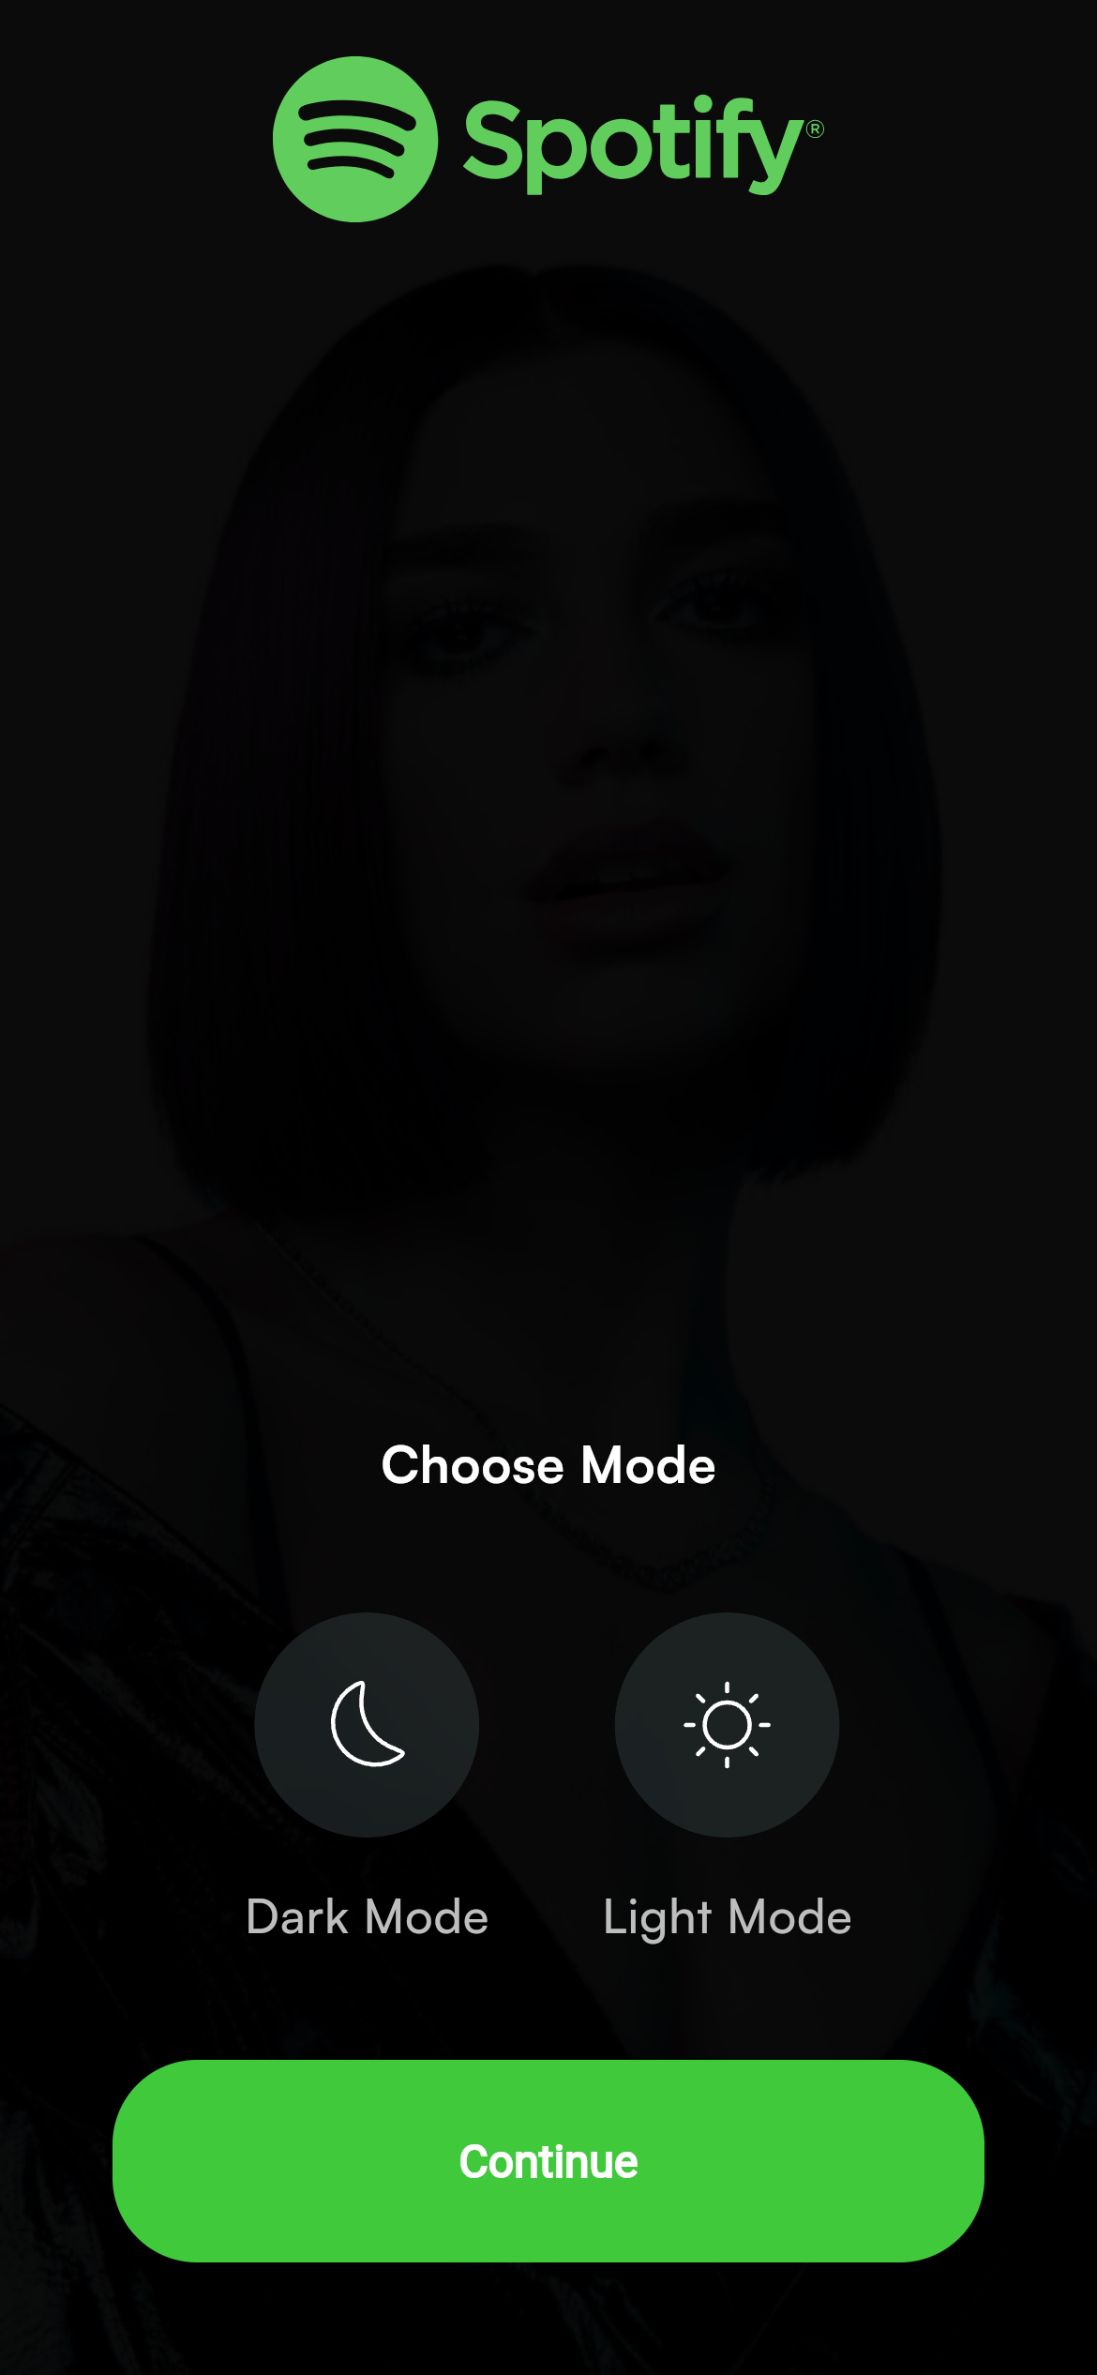
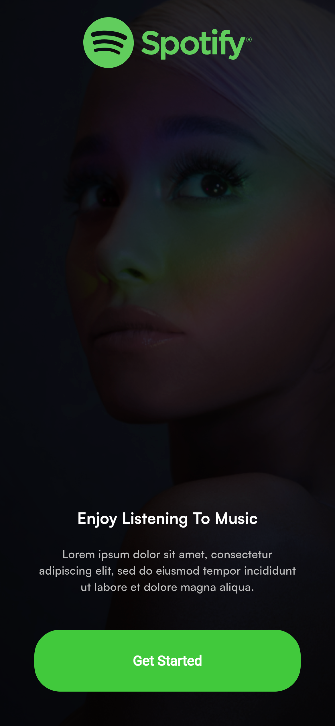
User Interface and Experience
UI Wireframes/Screenshots

Slide 10
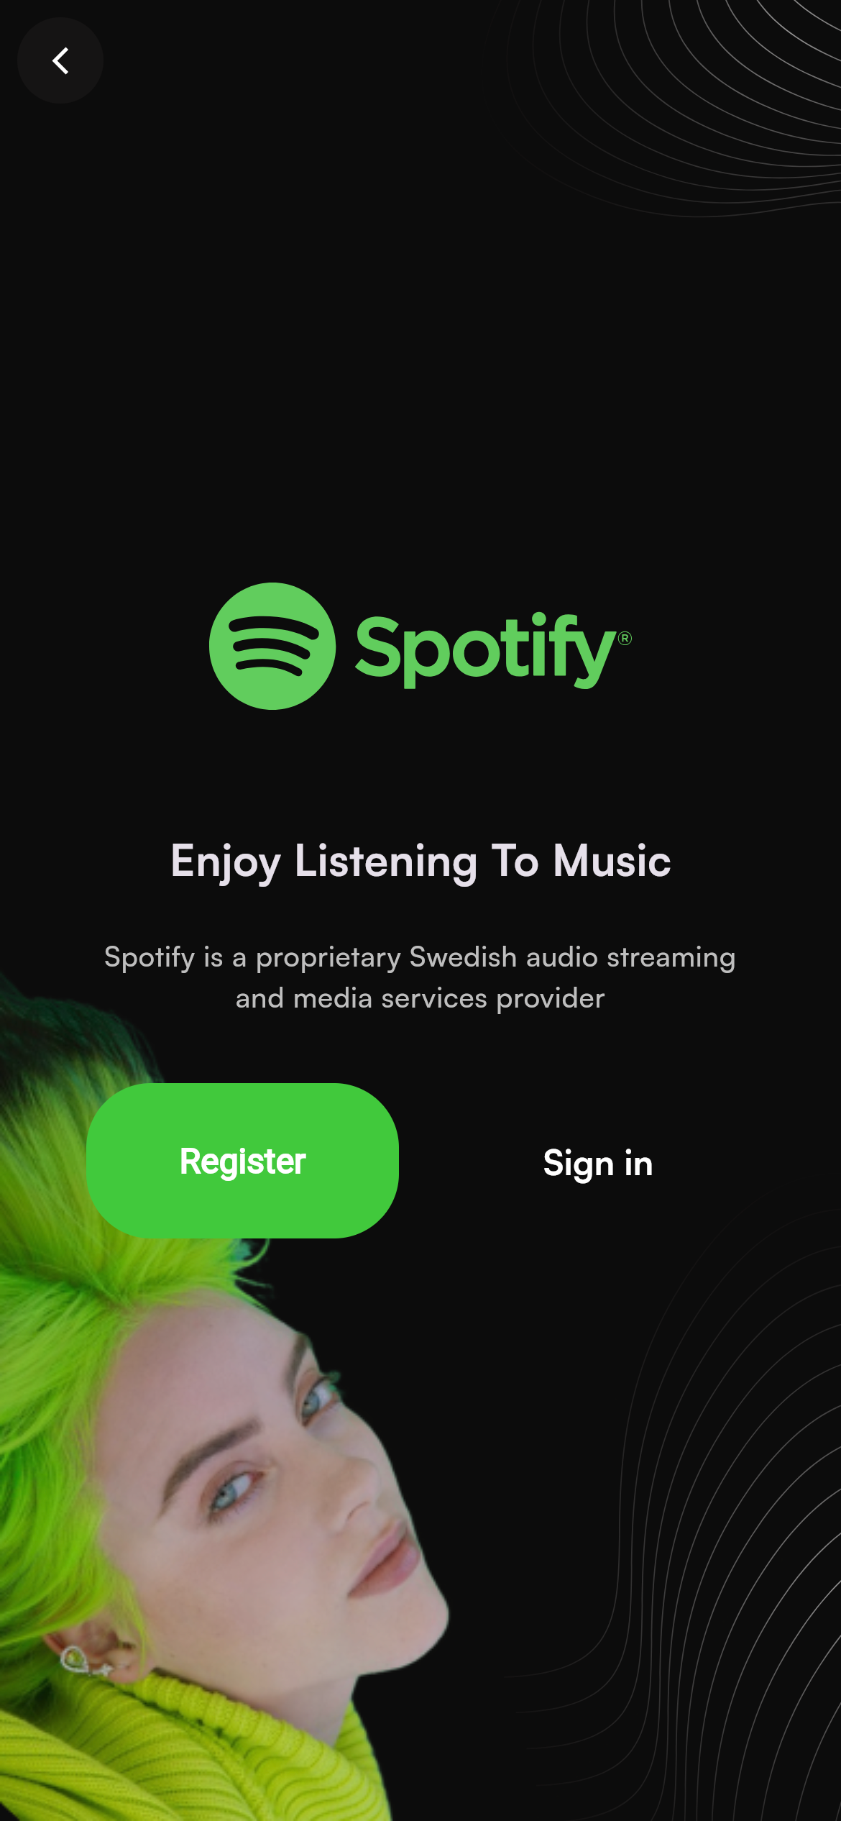
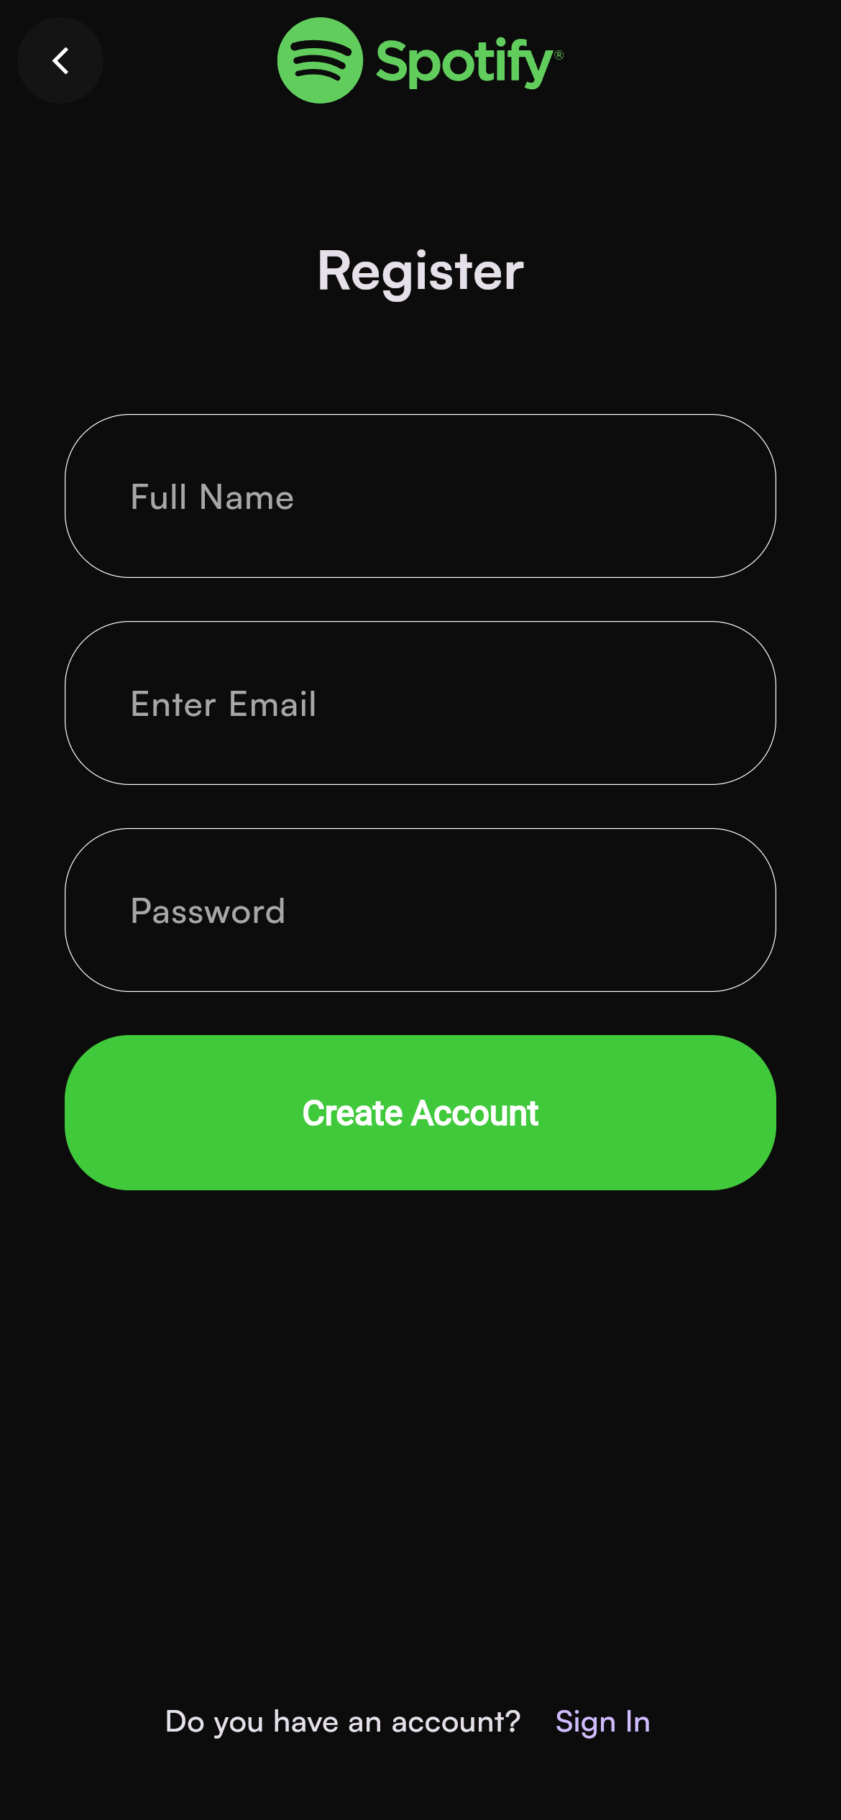
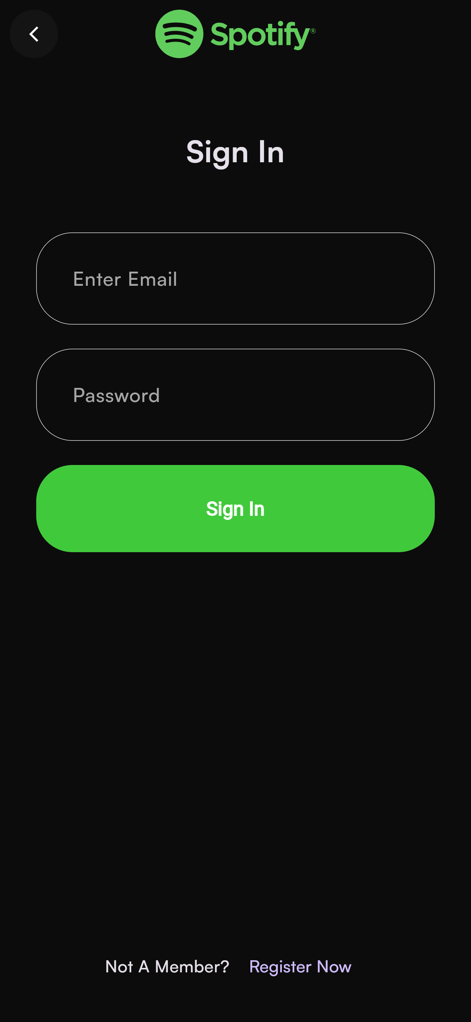
User Interface and Experience
UI Wireframes/Screenshots

Slide 11
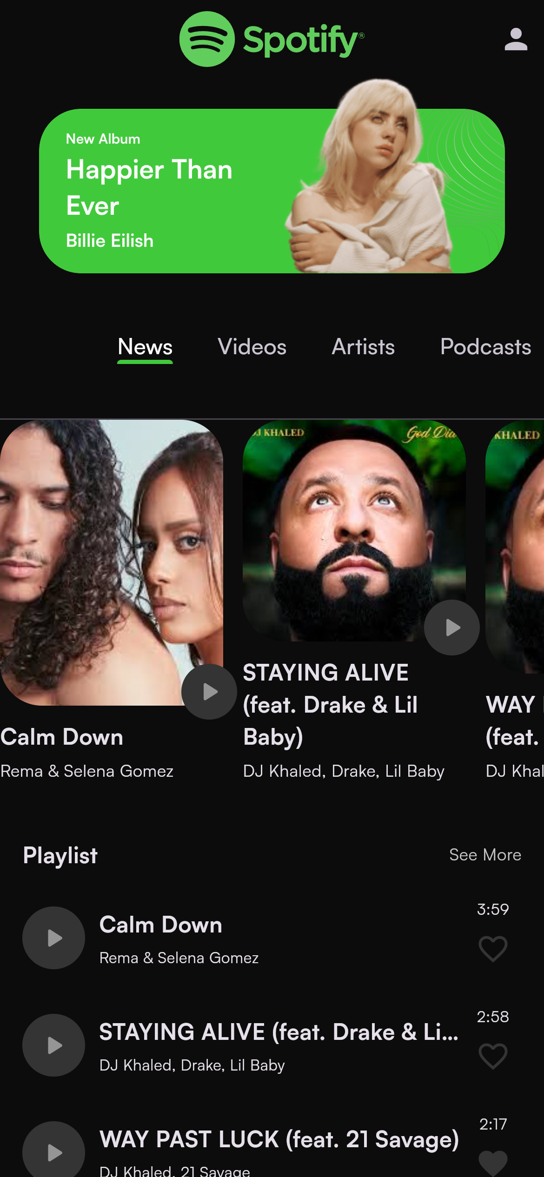
User Interface and Experience
Home Page: Displays new releases and playlists.

Slide 12
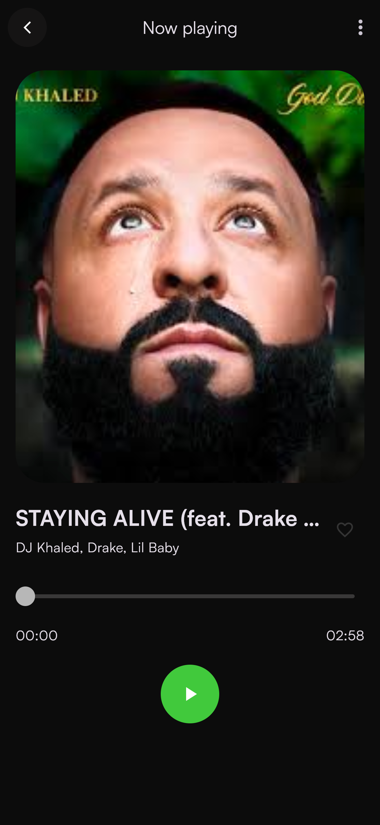
User Interface and Experience
Music Player: Shows song details with playback controls.

Slide 13
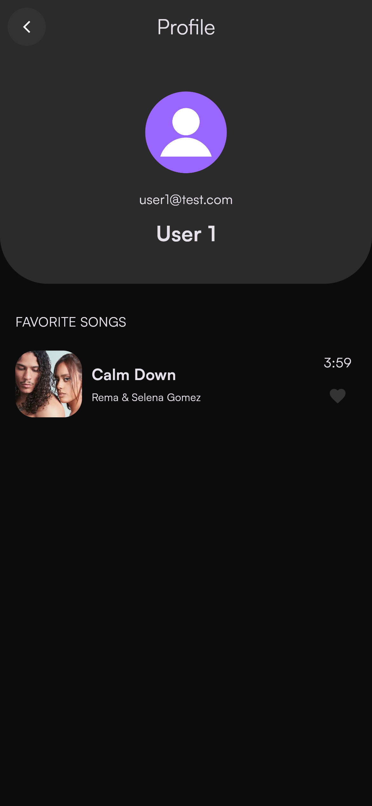
User Interface and Experience
Profile Page: User’s profile information and favorites list.

Slide 14
User Interface and Experience
Design Rationale
Minimalistic UI: Ensures ease of navigation and focus on content.
Consistent Theming: Dark and light modes for better accessibility.
Responsive Design: Optimized for various screen sizes.

Slide 15
Key Features and Functionalities
Feature List
Music Playback:
Real-time position tracking and playback controls.
Favorites Management:
Add/remove songs from favorites.
User Authentication:
Secure login and data storage via Firebase.
Dynamic Content Fetching:
Real-time song and user data updates from Firestore.

Slide 16
Key Features and Functionalities
Event Flows
User Login Flow
Diagram: Login -> Firebase Authentication -> User Dashboard.
Favorite Song Management Flow
Diagram: User selects favorite -> Firestore update -> UI refresh.
Music Playback Flow
Diagram: User presses play -> AudioPlayer -> Real-time slider updates.

Slide 17
Accessibility and Internationalization
Accessibility Features
High-contrast themes for better visibility.
Large, tappable controls for ease of use.
Dynamic font scaling for readability.
Internationalization Approach
Placeholder for language support in Firebase.
Potential for locale-based resource loading.

Slide 18
Challenges and Learnings
Development Challenges
Syncing real-time data with Firestore.
Managing audio streams efficiently.
Ensuring seamless state transitions for UI updates.
Key Learnings
Effective use of Cubit for state management.
Leveraging Firebase’s full suite for app backend.
Importance of modular code for scalability.

Slide 19
Future Enhancements
Proposed Improvements
Offline music playback support.
Enhanced playlist management features.
Multi-language support.
Roadmap
Q1 2025: Implement offline mode.
Q2 2025: Add multi-language support.
Q3 2025: Introduce user-driven playlists.

Slide 20
Appendix

Slide 21
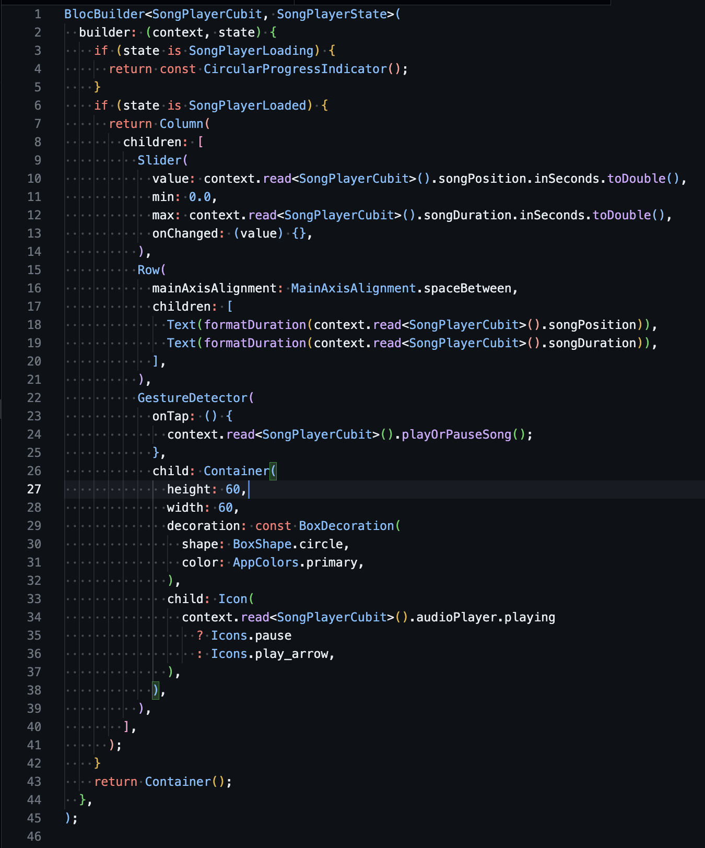
Code Snippets
Song Player Integration
Purpose: Displays a song’s details and playback controls with real-time slider updates.

Slide 22
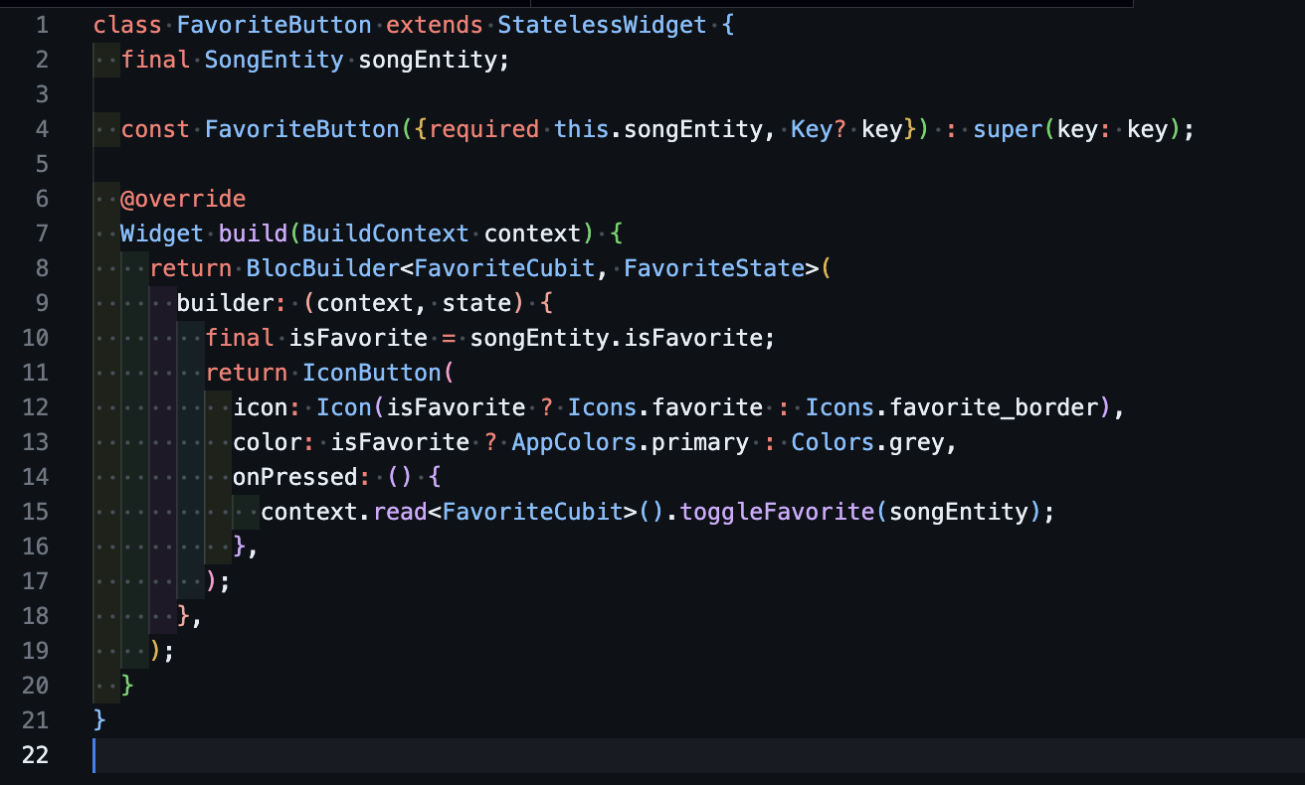
Code Snippets
2. Favorite Button Component
Purpose: Toggles a song’s favorite state, updating the Firestore database.

Slide 23
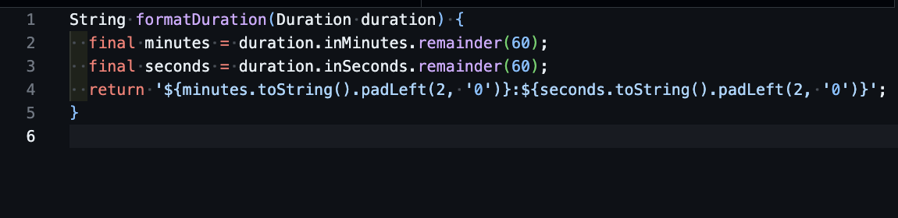
Code Snippets
3. Format Duration Helper
Purpose: Converts Duration into a readable MM:SS format for UI display.

Slide 24
Appendix
References and Resources
Firebase Documentation.
Just Audio Plugin for Flutter.
Design inspiration from Spotify App.

